Slide 1
Understanding Data Engineering Concepts and Importance
Prof. M.D.NAWALE

Slide 2
Examination Scheme and credits
Continuous Assessment : 20 Marks
Mid Semester Exam: 20 Marks
End Semester Exam: 60 Marks (Duration 03 hrs.)

Slide 3
Course Objectives
To learn data engineering concepts, Advanced Excel, Power BI, Tableau, and basic data analysis for effective data manipulation and visualization.

Slide 4
Course Outcomes
CO1 Understand the importance of data engineering and its workflow in managing and integrating data from various sources.
CO2 Apply advanced data manipulation techniques using Excel functions and tools for efficient data processing.
CO3 Utilize Power BI to connect, transform, and model data from diverse sources into meaningful relationships
CO4 Employ Tableau to prepare and transform data through connections, blending, and calculated fields.
CO5 Integrate and automate data pipelines across tools to streamline data workflows and promote collaboration

Slide 5
Syllabus
Unit No 1: Introduction to Data Engineering and Data Analysis Fundamental [7 Hours]
Understanding Data Engineering concepts and importance, Workflow and pipeline, Data sources and data integration. Basic Concepts of Data Analysis: Data types: Categorical, numerical, ordinal, and time-series data, Data distribution: Measures of central tendency and dispersion, Data visualization: Histograms, box plots, scatter plots, etc., Data preprocessing and cleaning, Exploratory Data Analysis (EDA).

Slide 6
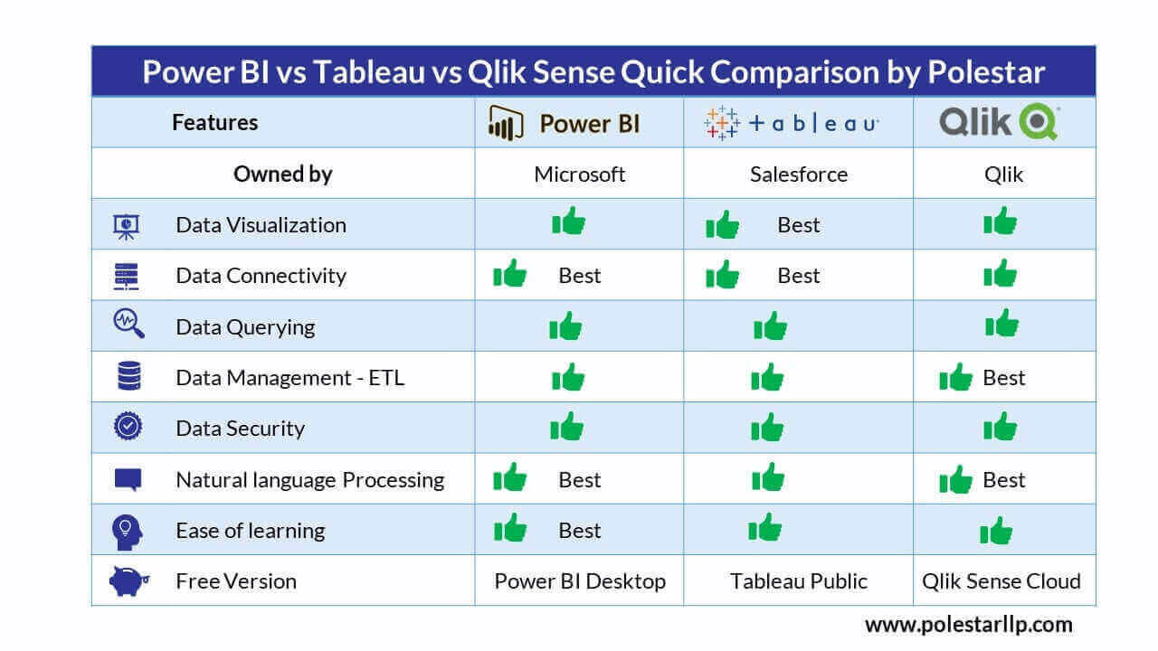
Data Visualization Tools

Slide 7
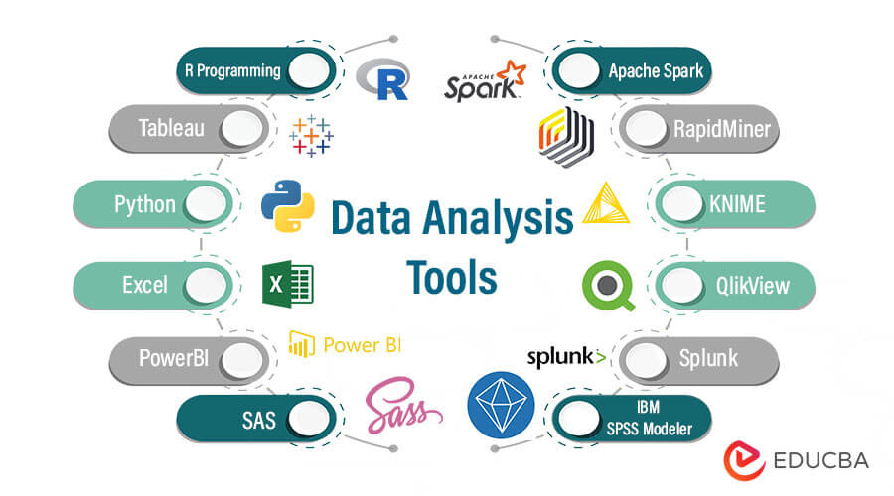
Data Analysis Tools

Slide 8
What is Data Engineering Concepts?
Data engineering basic concepts entail leveraging a set of manual and automated operations to build systems and protocols that support a seamless flow, as well as access to information in an organization.
Businesses usually employ specialized talents known as data engineers to perform this duty.

Slide 9
Importance of Data Engineering
Data engineering plays an important role in the era of big data.
Companies have access to so much information from the real and digital worlds.
While this can be a great boon to businesses, multiple data sources can also lead to information overload.
This results in scattered data, which restricts the organization from drawing relevant insights and seeing a clear picture of its business functions. That is where data engineering plays an integral part.
It simplifies data and makes it more reliable and useful for data scientists to work with. Also, the data infrastructure built through data engineering allows organizations to leverage the valuable benefits of data analytics.

Slide 10
Responsibilities
Analyze and organize raw data
Build data systems and pipelines
Evaluate business needs and objectives
Interpret trends and patterns
Conduct complex data analysis and report on results
Prepare data for prescriptive and predictive modeling
Build algorithms and prototypes
Combine raw information from different sources
Explore ways to enhance data quality and reliability
Identify opportunities for data acquisition
Develop analytical tools and programs
Collaborate with data scientists and architects on several projects

Slide 11
Prescriptive and Predictive Modeling
Predictive Analytics: It predicts what is most likely to happen in the future.
Prescriptive Analytics: It recommends actions you can take to affect those outcomes.

Slide 12
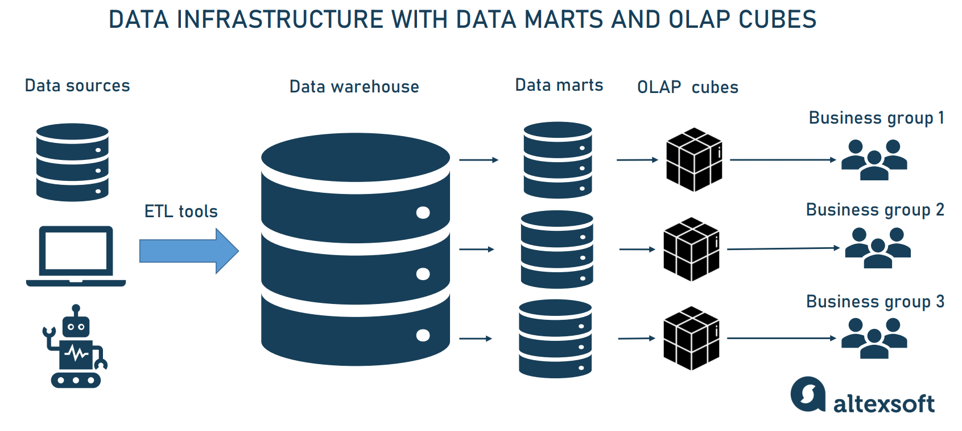
Workflow of Data Engineering

Slide 13
What is Data Engineering Process?
A typical data engineering process includes:
Data Flow: This process enhances a standard data flow through a data pipeline to streamline data-driven models, such as ML models for real-time analysis.
Data Normalization and Modelling: This process entails transforming data into easily accessible and usable formats to drive business decisions.
Data Cleaning: Data cleaning eliminates incorrectly formated, incomplete, or corrupted data from a data set when merging multiple data sources.
Data Accessibility: This includes enhancing the experience of data access, as well as visualization using custom tools, charts, and illustrations.

Slide 14
Key Steps of Data Engineering
Here are the key steps of data engineering:
Data Pipeline
Data Warehouse Definition
Data Marts
OLAP and OLAP Cubes
Big Data Concepts
Data Architecture as a Service

Slide 15
1. Data Pipeline
A data pipeline includes big data tools and protocols used to move data from one storage system to another one, usually for further storage or handling.
Data pipeline technology combines data from multiple sources by capturing and transferring it into another tool, app, or database for more seamless access by collaborating teams.
It takes an experienced data engineer, well versed with programming skills and technologies to build a data pipeline that can power around-the-clock data exchange.
Other business applications of a data pipeline include:
Data migration to the cloud and data warehouse
Data integration from IoT systems or interconnected devices
Data centralization to drive business decisions
Data wrangling, especially in machine learning projects

Slide 16
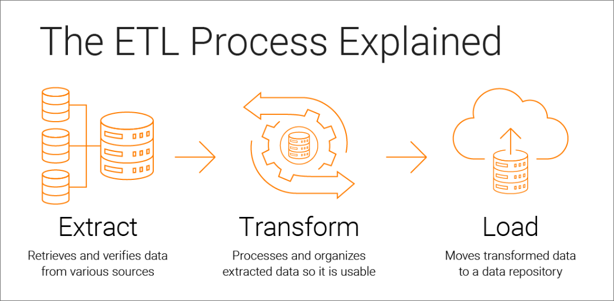
ETL Data Pipeline Steps

Slide 17
ETL
Extract, Transform, and Load describes the set of processes to extract data from one system, transform it, and then load it into a target repository.
Extract: the process of pulling data from a source such as an SQL or NoSQL database, an XML file or a cloud platform holding data for systems such as marketing tools, CRM systems, or transactional systems.
Transform: the process of converting the format or structure of the data set to match the target system.
Load: the process of placing the data set into the target system which can be a database, data warehouse, an application, such as CRM platform or a cloud data warehouse, data lake or data lakehouse from providers such as Snowflake, Amazon RedShift, and Google BigQuery.

Slide 18
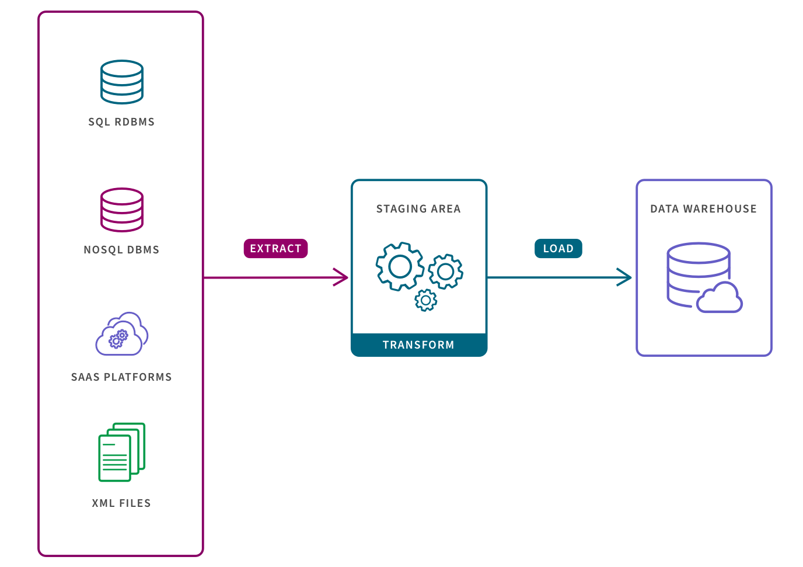
Extract, Transform, Load

Slide 19
Steps of the ETL data pipeline:
Extracting Data
This is the first step of an ETL data pipeline, where raw data is retrieved from multiple incoming channels, such as social media and business websites.
Data engineers usually program codes to run scheduled data extraction cycles for specific periods.
Transforming Data
This step involves modifying raw and inconsistent data extracted at the first stage of the ETL data pipeline.
Data engineers usually transform the data and segregate it in different formats, sizes, or even colors for optimal querying and analysis.
Typically, this stage ensures that the collected data is easily usable and discoverable.

Slide 20
Loading Data
Data extraction and transformation are followed by loading the usable data into various destinations, such as a data warehouse.
Some data engineers prefer using Hadoop or a relational database management system (RDBMS).
A complete ETL data pipeline process can be followed by storage in another system, where key organization leaders can access the same for business intelligence analysis, report generation, and visual creations.

Slide 21
Data Pipeline Challenges
Data pipelines are beneficial to businesses in many ways, especially when it comes to real-time and predictive analytics.
However, building a custom or standard data pipeline can be pretty daunting, especially for first-time organizations. Here are the five prevalent data pipeline challenges:
Data Placement
Businesses need to store their data in the right format and in the right location to enhance seamless access, as well as usability.
Making the right decision can be challenging, given that businesses must use multiple tools and connect them to numerous data stores and formats, especially if they are going to harness the full power of big data.

Slide 22
Data Pipeline Challenges
Data Scaling
Data scaling can be challenging, given that modern businesses handle up to 2.5 quintillion bytes of data generated by consumers every day.
At the same time, the number of data sources, whether sensors or IoT devices, may increase unexpectedly. With this in mind, organizations should have data storage options that are automatically scalable.
However, data scaling issues are more challenging among organizations that use on-premise storage solutions.
For instance, overwhelming data velocity and volume sharding and replication create more space for incoming data.
In the long haul, these processes can prove costly in terms of operations because a single technical hitch can mean hours of troubleshooting the whole system.

Slide 23
Data Pipeline Challenges
Data Flexibility
A whole data pipeline system relies on the entire ETL (Extract-Transform-Load) process.
Although this process is often meticulous, a single hitch in one step can cause hours of downtime, something that can affect data quality.
The situation even gets trickier if a business deals with dynamic data sources and events, which might mean setting up schemas for real-time data analytics.
At the same time, an ETL data pipeline that is used for data analytics must be optimally elastic for compatibility with various data types and schemas.

Slide 24
Data Hosting
Data hosting can either be done in the cloud or on-premise. Choosing the right hosting service can be challenging, especially if you have to modify the data into a specific format. That’s why some organizations choose to self-host their servers, but this option also comes with operating system, latency requirements, as well as memory and disk challenges.
Data Migration
Data migration techniques depend on how an organization uses its data.
However, most businesses choose to migrate their data during off-peak periods, such as at night, so as to minimize unnecessary downtime.
Although this might sound convenient, it gets challenging when it comes to real-time analytics, as the migrated data will be from the previous day.

Slide 25
2. Data Warehouse Definition
A data warehouse is a central repository, usually, a relational database, modified and optimized to support data reading, aggregation, and querying.
Although traditional data warehouses only supported structured data formatted in tables, modern applications can support both structured and unstructured data formats.
Unstructured data in this case include information formatted and presented as images, PDF files, or even audio files.
Data warehouse concepts as a single point of truth and information in an organization.
As opposed to retrieving data from multiple storage, data warehousing allows business analysts to report similar results and create near-accurate metrics for predictive analytics.

Slide 26
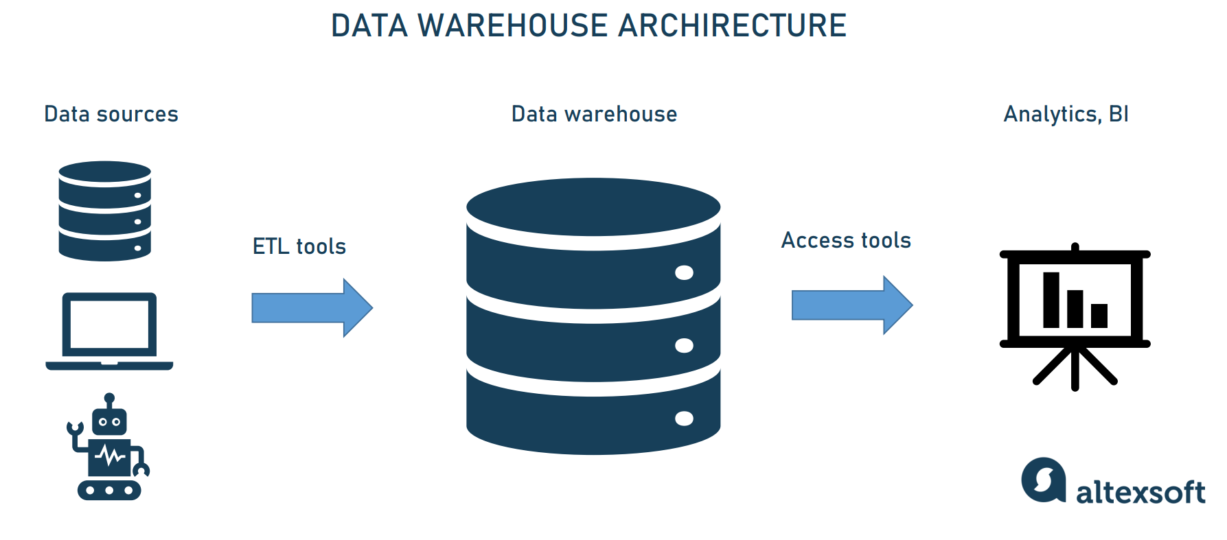
Data Warehouse Architecture
A typical data warehouse architecture includes three basic components:

Slide 27
Data Warehouse Storage
A central repository or a database is the bloodline of a custom or standard data warehouse architect, as all business data is stored where.
Business leaders and other employees can then access the data warehouse storage to draw valuable insights from its contents.
Businesses have the option of either an on-premise or cloud-based data warehouse storage.
The former option is ideal for organizations that want to process their data at high querying speeds and uncompromised security.
On the other hand, cloud-based data warehouses support automatic scalability and any data structure. They are also relatively affordable than their on-premise counterparts.
Some data architects might also help you build collective storage options that run parallel as a centralized warehouse. This approach is usually ideal when enhancing scalability.

Slide 28
Data Warehouse Storage
Metadata
Metadata contains the information and guidelines for changing and processing data when loading it into a warehouse environment.
Access Tools
These are tools that are integrated into the warehouse architecture to facilitate access, as well as interactions of the stored data with end-users. These tools might include querying, reporting, or data mining tools, based on the model of the data warehouse model.
Management Tools
Data warehouse tools help businesses perform automated administrative duties.

Slide 29
3. Data Marts
Data mart is a smaller data warehouse (their size is usually less than 100Gb.).
They become necessary when the company and the amount of its data grow and it becomes too long and ineffective to search for information in an enterprise DW.
Instead, data marts are built to allow different departments (e.g., sales, marketing, C-suite) to access relevant information quickly and easily.
Data marts exist in three prevalent types, including:
Dependent data marts are created from an enterprise DW and used as a primary source of information (also known as a top-down approach).
Independent data marts are standalone systems that function without DWs extracting information from various external and internal sources (it’s also known as a top-down approach).
Hybrid data marts combine information from both DW and other operational systems.

Slide 30
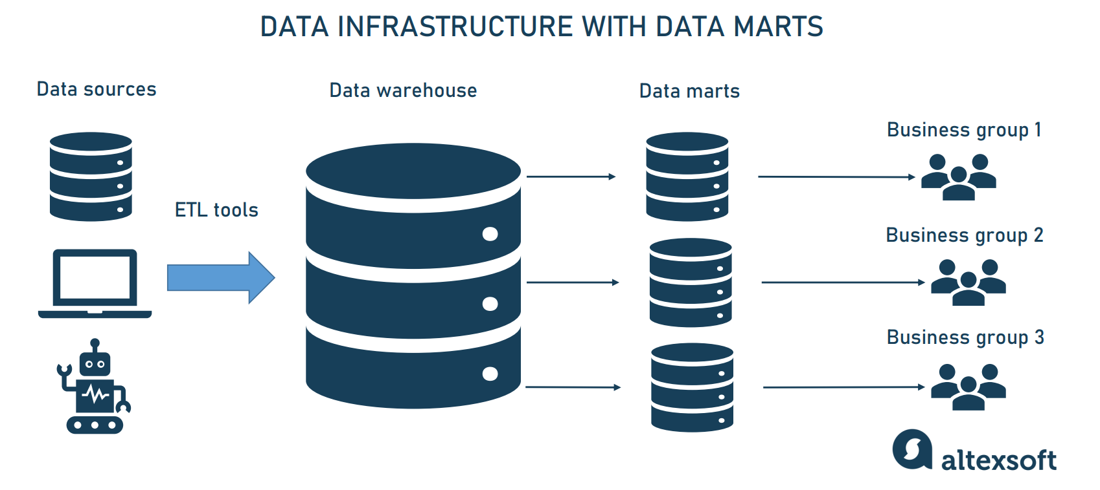
Data Marts

Slide 31
Data warehouses vs Data marts
So, the main difference between data warehouses and data marts is that a DW is a large repository that holds all company data extracted from multiple sources, making it difficult to process and manage queries.
Meanwhile, a data mart is a smaller repository containing a limited amount of data for a particular business group or department.

Slide 32
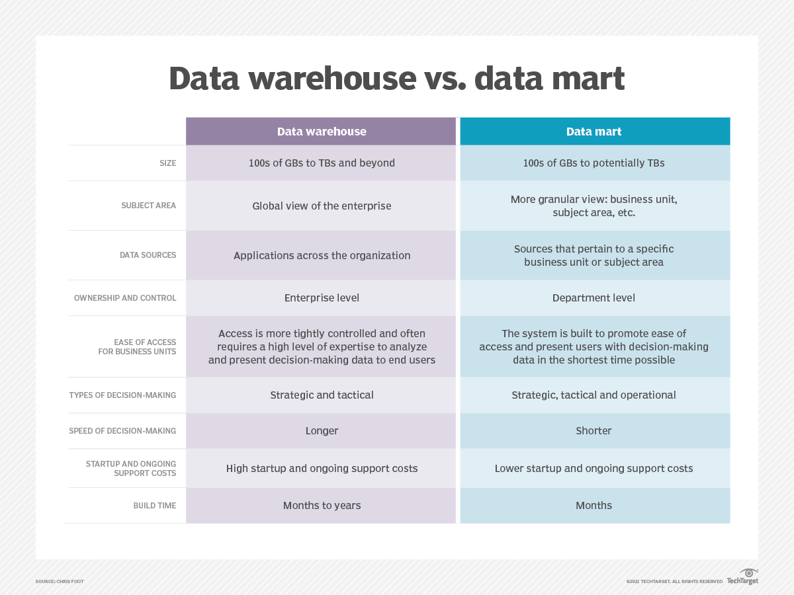

Slide 33
4. OLAP and OLAP Cubes
OLAP is a simple abbreviation for Online Analytical Processing. This computational program allows business analysts and data engineers to take a multidimensional approach to data analysis. In other words, this tech helps organizations vast data from different angles, as opposed to OLTP.
OLAP cubes are the multidimensional structures that represent data. However, unlike traditional database representation (usually in rows and columns), which can be generated automatically, OLAP cubes must be custom-built for individual reporting and analytical querying.
There are multiple steps of OLAP:
First, data is first extracted from various data sources and formats, like text files and spreadsheets. This data is then stored in the Data Warehouse.
Next, the data is cleaned, transformed, and stored in OLAP Cubes
Once in the OLAP cubes, information is then pre-calculated and pre-aggregated in advance for further analysis
Lastly, the user gets the data from the OLAP cubes by running queries against them

Slide 34
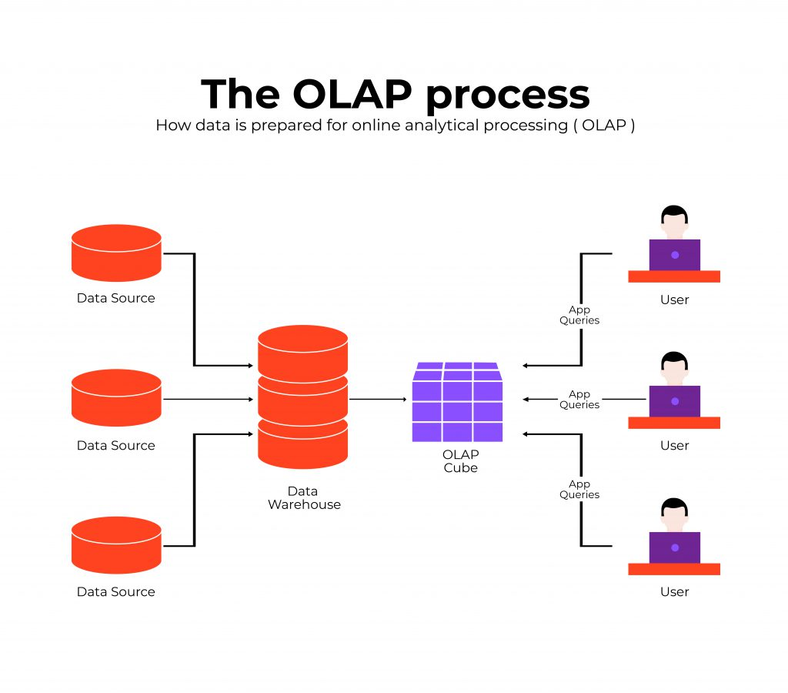
OLAP Process

Slide 35
5. Big Data Concepts
Big data is a collection of data from many different sources and is often describe by five characteristics: volume, value, variety, velocity, and veracity.
The architecture used in big data applications varies accordingly with the amount of data involved. Organizations that employ big data technology usually use a data lake to power the infrastructure, instead of a traditional data warehouse.
Prevalent big data concepts include:
Data Lake
Hadoop
Enterprise Data Hub

Slide 36
6. Data Architecture as a Service
Data architecture-as-a-service is an approach taken by business data users to circumvent data bottlenecks by building local repositories.
Typically, the process doesn’t sacrifice enterprise data integrity or consistency. This service can exist as an extension model or a self-service data engineering approach.
Data Sources and Data Integration
Basic Concepts of Data Analysis
Data analysis is the process of cleaning, changing, and processing raw data and extracting actionable, relevant information that helps businesses make informed decisions.
The procedure helps reduce the risks inherent in decision-making by providing useful insights and statistics, often presented in charts, images, tables, and graphs.
A simple example of data analysis can be seen whenever we make a decision in our daily lives by evaluating what has happened in the past or what will happen if we make that decision. Basically, this is the process of analyzing the past or future and making a decision based on that analysis.

Slide 37
Data Source
Data source refers to the physical or digital location where data can be stored as a data table, data object, or another storage format. It’s also where someone can access data for further use — analysis, processing, visualization, etc.
Most data sources can be divided into two main categories:
1) machine data sources
2) file data sources.
E.g. - you want to analyze your sales to understand how to enhance your store performance. You decided that you would use Tableau for data processing. As it is a standalone tool, you must somehow fetch the data you need from Kaggle. Thus, kaggle will act as a data source for your further data manipulations.

Slide 38
Data Source vs Database
A database is a structured collection of data, typically stored electronically in a computer system. A database is usually organized so that it can be easily accessed, managed, and updated. A Database is typically managed by a Database Management System (DBMS), which provides access to the data in the form of queries and reports.
E.g.= financial records(that can be organized and retrieved quickly and easily.)
Databases come in many types to serve different purposes. There are two main types of databases: relational (SQL) and non-relational (NoSQL).
On the contrary, a data source is an entity that holds data, such as a file, a web service, an application, or a combination of these resources. A database can also be a data source, but it is not the only possible type.

Slide 39
1) Machine Data Sources
The machine data source is created on the client machine, be it a computer, a phone, an Internet of things, or another device.
It is available to users currently logged onto the system and cannot be shared with other machines.
They can be further categorized into User data sources (available only to a particular user) and System data sources (available to all the system users).
Machine data source examples include network traffic logs, system and application logs, output from sensors, event data from IoT devices, database query results, etc.

Slide 40
2) File Data Sources
File Data Sources are not assigned to particular machines, applications, systems, or users.
They can be shared between devices.
These data sources are usually stored in separate text files.
They do not have a data source name (DSN) like machine data sources.
Such data sources include spreadsheets, text documents, PDFs, images, and audio and video files.

Slide 41
Data Integration
Data Integration is the process of obtaining and combining multiple data sources for use in an application.
The concept of data integration has gained wide prominence after the introduction of the (WWW) World Wide Web and the huge amount of information associated with it.
Though a large amount of data is available, their formats differ considerably due to the unavailability of a regulated schema in the system. Hence data integration becomes mandatory.
Data integration also plays a key role in the process of building data pipelines that deliver data to users for both operational and analytics uses.
Many pipelines pull data from integrated systems and applications to provide the required information.

Slide 42
Challenges to data integration
How to get to the finish line: Companies typically know what they want from data integration (the solution to a specific challenge). What they often don’t think about is the route it will take to get there.
Anyone implementing data integration must understand what types of data need to be collected and analyzed, where that data comes from, the systems that will use the data, what types of analysis will be conducted, and how frequently data and reports will need to be updated.
Data from legacy systems : Integration efforts may need to include data stored in legacy systems. That data, however, is often missing markers such as times and dates for activities, which more modern systems commonly include.
Data from newer business demands : New systems today are generating different types of data (such as unstructured or real-time) from all sorts of sources such as videos, IoT devices, sensors, and cloud.

Slide 43
Challenges to data integration
Figuring out how to quickly adapt your data integration infrastructure to meet the demands of integrating all these data becomes critical for your business to win, yet extremely difficult as the volume, the speed, the new format of data all pose new challenges.
External data: Data taken in from external sources may not be provided at the same level of detail as internal sources, making it difficult to examine with the same rigor.
Also, contracts in place with external vendors may make it difficult to share data across the organization.
Keeping up: Once an integration system is up and running, the task isn’t done.
It becomes incumbent upon the data team to keep data integration efforts on par with best practices, as well as the latest demands from the organization and regulatory agencies.

Slide 44
Data Integration strategies for business
Manual data integration is simply the process by which an individual user manually collects necessary data from various sources by accessing interfaces directly, then cleans it up as needed, and combines it into one warehouse.
This is highly inefficient and inconsistent, and makes little sense for all but the smallest of organizations with minimal data resources.
Middleware data integration is an integration approach where a middleware application acts as a mediator, helping to normalize data and bring it into the master data pool. (Think about adapters for old electronic equipment with outdated connection points).
Middleware comes into play when a data integration system is unable to access data from one of these applications on its own.
Application-based integration is an approach to integration wherein software applications locate, retrieve, and integrate data.

Slide 45
Data Integration strategies for business
During integration, the software must make data from different systems compatible with one another so they can be transmitted from one source to another.
Uniform access integration is a type of data integration that focuses on creating a front end that makes data appear consistent when accessed from different sources.
The data however is left within the original source. Using this method, object-oriented database management systems can be used to create the appearance of uniformity between unlike databases.
Common storage integration is the most frequently used approach to storage within data integration. A copy of data from the original source is kept in the integrated system and processed for a unified view.
This is opposed to uniform access, which leaves data in the source. The common storage approach is the underlying principle behind the traditional data warehousing solution.

Slide 46
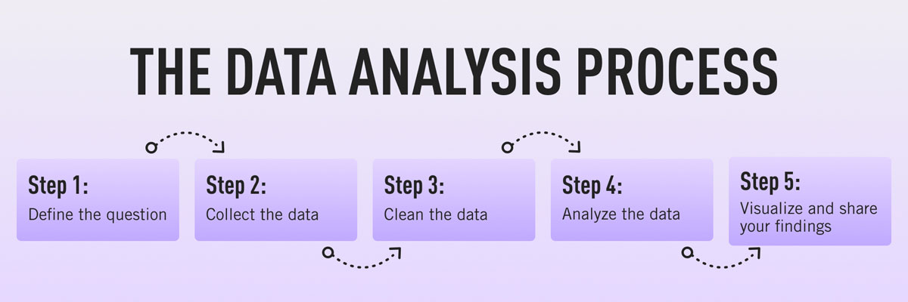
Basic Concept of Data Analysis
Data analytics is the process of analyzing raw data in order to draw out meaningful, actionable insights which are then used to inform and drive smart business decisions.

Slide 47
Data Types: Categorical data
Categorical data represent characteristics such as
a person’s gender
marital status
hometown
the types of movies they like.
Categorical data can take on numerical values (such as “1” indicating male and “2” indicating female).
But those numbers don’t have mathematical meaning. You couldn’t add them together.

Slide 48
Data Types: Numerical data
These data have meaning as a measurement, such as a person’s height, weight, IQ, or blood pressure; or they’re a count, such as the number of stock shares a person owns.
how many teeth a dog has, or how many pages you can read of your favorite book before you fall asleep.
Statisticians also call numerical data quantitative data.
Numerical data can be further broken into two types:
Discrete
Continuous.

Slide 49
Discrete data vs Continuous data
Discrete Data | Continuous Data
Discrete data are countable and finite; they are whole numbers or integers | Continuous data are measurable; they are in the form of fractions or decimal
Discrete data are represented mainly by bar graphs | Continuous data are represented in the form of a histogram
The values cannot be divided into subdivisions into smaller pieces | The values can be divided into subdivisions into smaller pieces
Discrete data have spaces between the values | Continuous data are in the form of a continuous sequence
Examples: Total students in a class, number of days in a week, size of a shoe, etc | Example: Temperature of room, the weight of a person, length of an object, etc

Slide 50
Ordinal Data
Ordinal data have natural ordering where a number is present in some kind of order by their position on the scale.
These data are used for observation like customer satisfaction, happiness, etc., but we can’t do any arithmetical tasks on them.
Examples :
When companies ask for feedback, experience, or satisfaction on a scale of 1 to 10
Letter grades in the exam (A, B, C, D, etc.)
Ranking of people in a competition (First, Second, Third, etc.)
Economic Status (High, Medium, and Low)

Slide 51
Time Series
Time series analysis in statistics refers to a technique that involves conducting an analysis of various data points collected during a certain timeframe.
It provides insights and consequences of a given data set’s features changing over time.
Individuals analyzing time series data record the data points at fixed intervals over a particular period.
This type of analysis has applications in multiple areas, including economics, sales, and statistics.

Slide 52
Data distribution: Measures of central tendency and dispersion
Measures that indicate the approximate center of a distribution are called measures of central tendency.
Measures that describe the spread of the data are measures of dispersion.
These measures includes:
Mean
The mean of a set of data is the sum of all values in a data set divided by the number of values in the set.
Median
The median of a set of data is the “middle element” when the data is arranged in ascending order.

Slide 53
Mode
The mode is the most frequently occurring measurement in a data set. There may be one mode; multiple modes, if more than one number occurs most frequently; or no mode at all, if every number occurs only once.
Range
The range is the difference between the lowest and highest values in a data set.
upper and lower quartiles
The quartiles of a group of data are the medians of the upper and lower halves of that set. The lower quartile, Q1, is the median of the lower half, while the upper quartile, Q3, is the median of the upper half.
Variance
variance is the average of all data points within a group.

Slide 54
Standard deviation
standard deviation is the square root of the variance
A standard deviation (or σ) is a measure of how dispersed the data is in relation to the mean.
Low, or small, standard deviation indicates data are clustered tightly around the mean, and high, or large, standard deviation indicates data are more spread out.

Slide 55
Data visualization
Data visualization is the representation of data through use of common graphics, such as charts, plots, infographics, and even animations.
These visual displays of information communicate complex data relationships and data-driven insights in a way that is easy to understand.
Histograms: To see the distribution of a set of continuous data.
Pareto charts: A bar chart, each bar length represent the frequency, and it is arranged from longest to shortest.
Scatter plots: Plots observations as points to show the relationship between two sets of data. for example heights and weight, experience and salary.

Slide 56
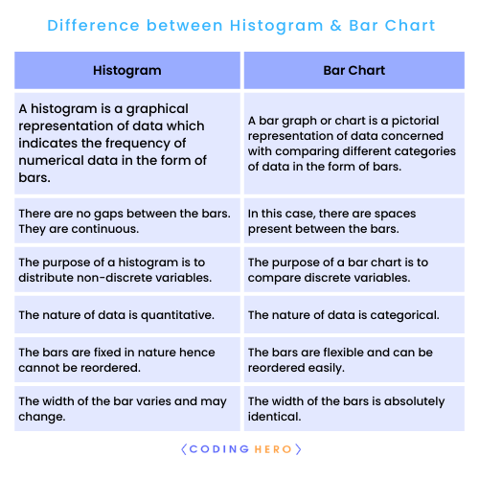

Slide 57
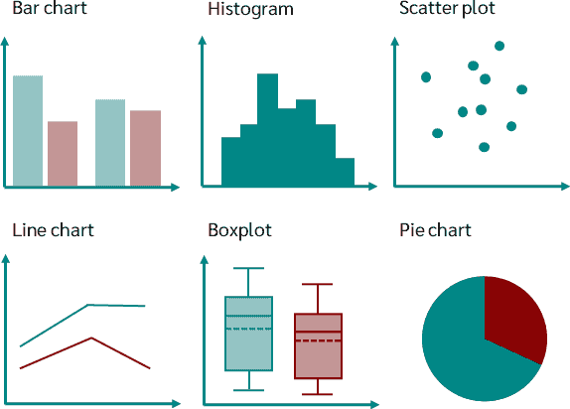

Slide 58
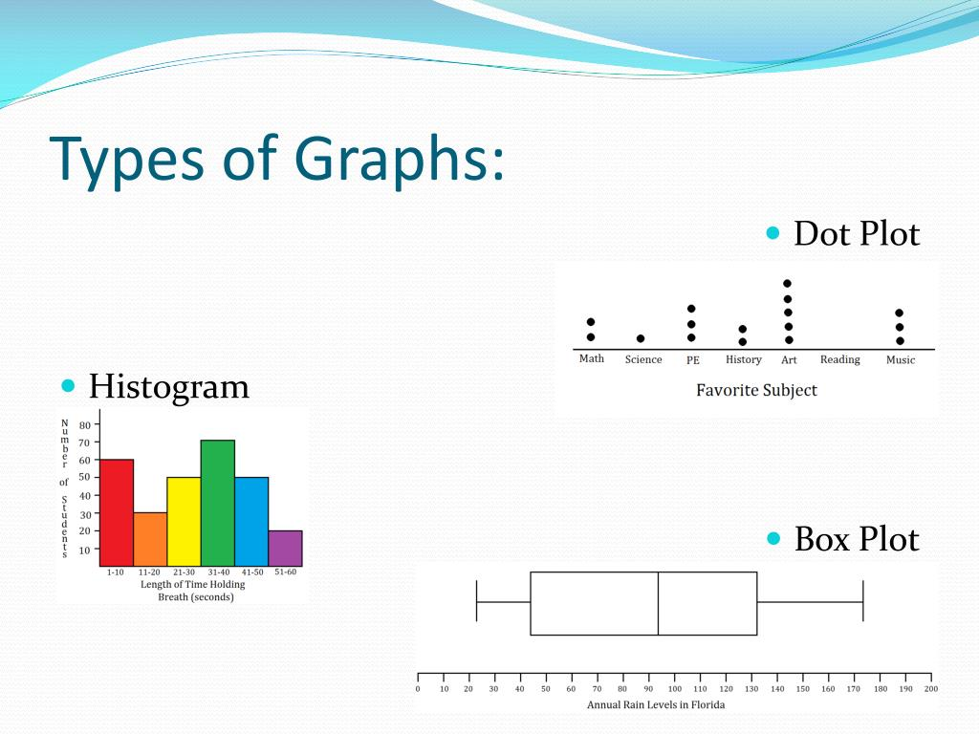

Slide 59
Data preprocessing and cleaning
Steps In Data Preprocessing:
Gathering the data
Import the dataset & Libraries
Dealing with Missing Values
Divide the dataset into Dependent & Independent variable
dealing with Categorical values
Split the dataset into training and test set
Feature Scaling

Slide 60
Data preprocessing and cleaning
Steps In Data Preprocessing:
Gathering the data
Here i am sharing some website with you to get the dataset :
Kaggle: Kaggle is my personal favorite one to get the dataset. https://www.kaggle.com/datasets
UCI Machine Learning Repository: One of the oldest sources on the web to get the dataset. http://mlr.cs.umass.edu/ml/
This awesome GitHub repository has high-quality datasets. https://github.com/awesomedata/awesome-public-datasets
If you are looking for Government’s Open Data then here is few of them: Indian Government: http://data.gov.in US Government: https://www.data.gov/ British Government: https://data.gov.uk/ France Government: https://www.data.gouv.fr/en/

Slide 61
Import the dataset & Libraries
Dealing with Missing Values
Check for null values, Drop Null values, Replacing Null values with Strategy
Divide the dataset into Dependent & Independent variable
After importing the dataset, the next step would be to identify the independent variable (X) and the dependent variable (Y).
Basically dataset might be labeled or unlabeled.
dealing with Categorical values
Use libraries.
Split the dataset into training and test set
In machine learning we usually splits the data into Training and Testing data for applying models.

Slide 62
Feature Scaling
Feature Scaling is a technique to standardize the independent features present in the data in a fixed range. It is performed during the data pre-processing.

Slide 63
Exploratory Data Analysis (EDA)
Exploratory Data Analysis (EDA) refers to the method of studying and exploring record sets to apprehend their predominant traits, discover patterns, locate outliers, and identify relationships between variables.
EDA is normally carried out as a preliminary step before undertaking extra formal statistical analyses or modeling.

Slide 64
Types of EDA
1. Univariate Analysis: This sort of evaluation makes a speciality of analyzing character variables inside the records set.
It involves summarizing and visualizing a unmarried variable at a time to understand its distribution, relevant tendency, unfold, and different applicable records.
Techniques like histograms, field plots, bar charts, and precis information are generally used in univariate analysis.
2. Bivariate Analysis: Bivariate evaluation involves exploring the connection between variables.
It enables find associations, correlations, and dependencies between pairs of variables.
Scatter plots, line plots, correlation matrices, and move-tabulation are generally used strategies in bivariate analysis.

Slide 65
3. Multivariate Analysis: Multivariate analysis extends bivariate evaluation to encompass greater than variables.
It ambitions to apprehend the complex interactions and dependencies among more than one variables in a records set.
Techniques inclusive of heatmaps, parallel coordinates, aspect analysis, and primary component analysis (PCA) are used for multivariate analysis.
4. Time Series Analysis: This type of analysis is mainly applied to statistics sets that have a temporal component.
Time collection evaluation entails inspecting and modeling styles, traits, and seasonality inside the statistics through the years.

Slide 66
Techniques like line plots, autocorrelation analysis, transferring averages, and ARIMA ( AutoRegressive Integrated Moving Average) fashions are generally utilized in time series analysis.
5. Missing Data Analysis: Missing information is a not unusual issue in datasets, and it may impact the reliability and validity of the evaluation.
Missing statistics analysis includes figuring out missing values, know-how the patterns of missingness , and using suitable techniques to deal with missing data.
Techniques along with lacking facts styles, imputation strategies, and sensitivity evaluation are employed in lacking facts evaluation.

Slide 67
6. Outlier Analysis: Outliers are statistics factors that drastically deviate from the general sample of the facts.
Outlier analysis includes identifying and knowledge the presence of outliers, their capability reasons, and their impact at the analysis.
Techniques along with box plots, scatter plots, z-rankings, and clustering algorithms are used for outlier evaluation.
7. Data Visualization: Data visualization is a critical factor of EDA that entails creating visible representations of the statistics to facilitate understanding and exploration.
Various visualization techniques, inclusive of bar charts, histograms, scatter plots, line plots, heatmaps, and interactive dashboards, are used to represent exclusive kinds of statistics.

Slide 68
Assignment-1
Explain key steps of data engineering
Describe Data Pipeline Challenges
Explain data types
Explain EDA & it’s types
Describe the Steps In Data Preprocessing
Explain the terms:
Data warehouse
Data Marts
OLAP and OLAP Cubes

